Slide 1
Big Data Analytics Application in Soil Investigation
Jinling Li

Slide 2
Agenda
Purpose
Design
Architecture
Data Source
Analytical Tools
Questions
Implementation
Data Warehouse
Statistical Analysis
Conclusion

Slide 3
Purpose
Soil investigation is of great significance to agriculture and environment.
Implement machine learning techniques to realize real-time soil property queries in national regions.
Notes:
I used to work in a national lab as an environmental specialist. My responsibility was to investigate soil properties in Mid-Atlantic Region. At that time, information was sparsely scattered and sometimes I felt aimless when I wanted to query soil properties. I believe it is important and necessary to gather data from various sources, and analyze and explore the possible relationships and hidden information using big data techniques, and finally deliver processed results to the users.
Soil properties include color, air content, water holding capacity, nutrient (N, P, and K), microelements, heavy metals, microbial activity, pH, etc.. It changes with depths, locations, and time. Farmers are interested in soil properties because they are very important for crop growth.
This project will provide a platform for users to explore soil properties information using big data analytics.

Slide 4
Design - Architecture
Data Source
Research report
Statistical Tools
Analytical Results
Visualization
R
Data Warehouse
Hadoop
Hive
Open source
Python
Notes:
The whole architecture is given as above: raw data gathered from data source (i.e., database, research report), are extracted, transformed, loaded and analyzed using big data (i.e., Hadoop, Hive, Metastore) and statistical tools (i.e., Excel and R), and then the results are shown in visualization.

Slide 5
Design - Data Source
Research report
Data mining, text mining, natural language processing
Existing soil database
Web Soil Survey
Notes:
Basically, data are gathered from 1) published research paper using text mining, data mining, and natural language processing techniques, 2) existing soil database, such as Web Soil Survey, which is an online database for soil survey. Data will be downloaded and saved in Hadoop readable format (i.e., .csv file, .txt file).

Slide 6
Design - Analytical Tools
Big data tools
Hadoop, Hive
Statistical tools
R and Python
Notes:
Big data tools including Hadoop, MapReduce, and Hive are used to create database and process the data. Statistical tools including R and Excel are used to analyze the data.

Slide 7
Design - Questions
What is the soil property in this certain region?
Is soil in the region contaminated?
Which soil region is better for a certain crop to grow?
What soil property will affect crop growth?
What events are happening that might affect soil properties in the region?
What soil property is of interest to farmers?
How does soil property change with depth, location and time?
Notes:
Farmers are interested in the soil properties because they are related to crop growth. This project can answer user’ questions above.

Slide 8
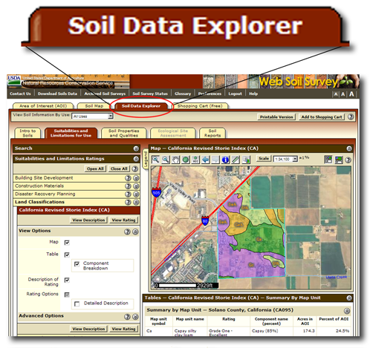
Implementation – Data Warehouse
Web Soil Survey
http://websoilsurvey.sc.egov.usda.gov/App/HomePage.htm
The data sets used in this project is obtained from soil database. Two sets of data with one indicating soil carbon and nitrogen, and the other showing heavy metals in the soil from Mid-Atlantic region are downloaded and saved in .csv files.
Notes:
The obtained .csv files can be as large as hundreds of MB. Therefore, it is usually inaccessible from Excel directly. Big data analytics are needed in order to access this complex large data set.

Slide 9
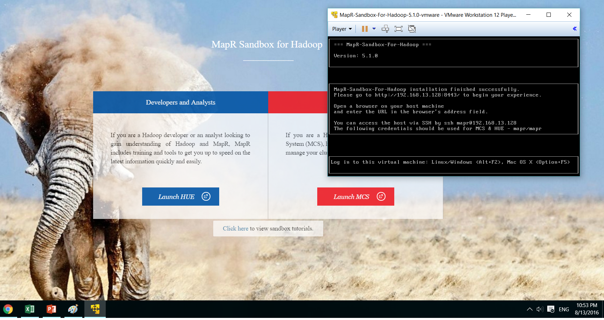
Implementation – Data Warehouse
The original .csv files are uploaded in HUE interface from MapR sandbox.
Notes:
MapR Sandbox for Hadoop 5.1 are used and run on a Vmware VM 12 platform. As shown above, a HUE interface is provided by this platform.

Slide 10
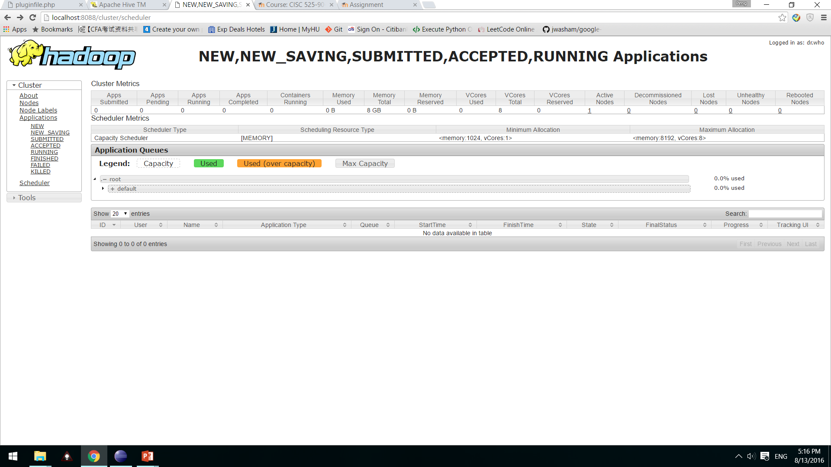
Implementation – Data Warehouse
Notes:
Hue is a web interface for Hadoop. Apache Hive is a data warehouse software built on Hadoop. Above is a close up of Hadoop server.

Slide 11
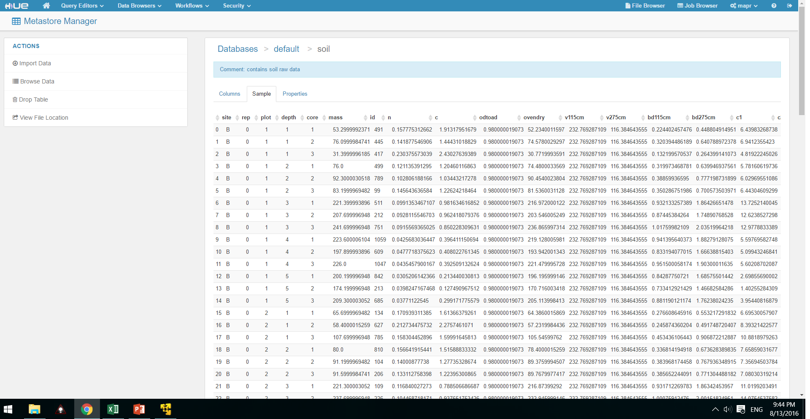
Implementation – Data Warehouse
Metastore Table – soil C and N
Notes:
First, upload files into system, and create metastore tables from files. As you can see, original tables are complex, redundant, and inaccessible from Excel. A database is created and data are imported into metatables.

Slide 12
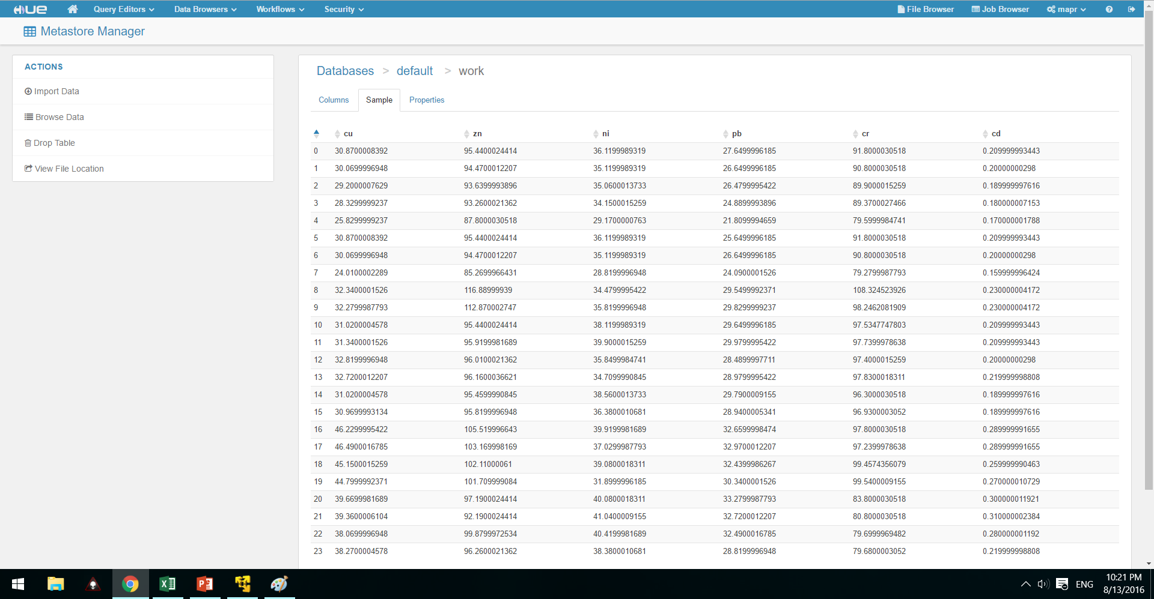
Implementation – Data Warehouse
Metastore Table – heavy metals
Notes:
First, upload files into system, and create metastore tables from files.

Slide 13
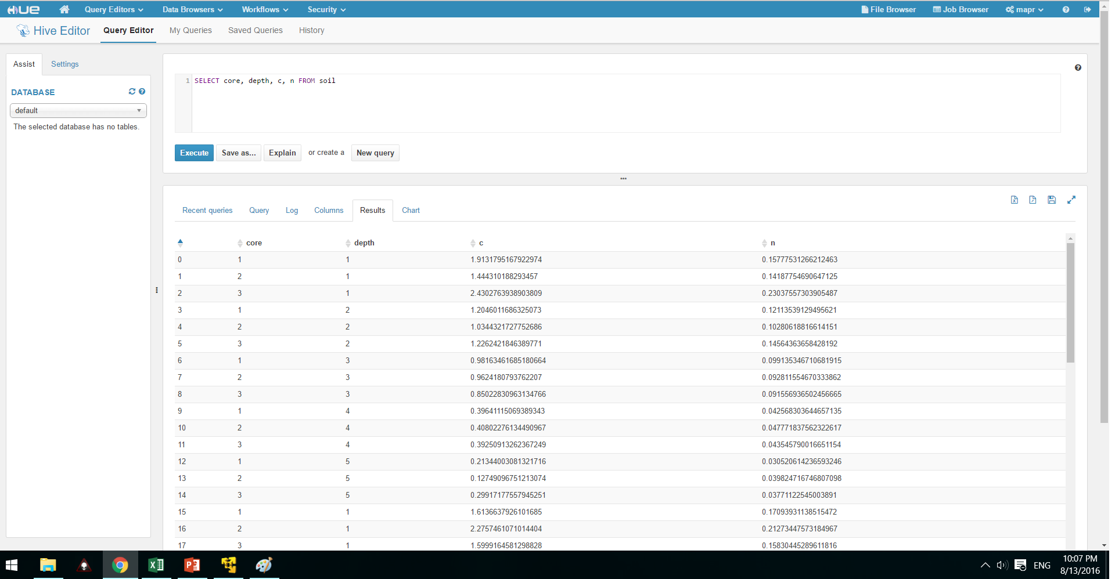
Implementation – Data Warehouse
Hive query results from HUE – soil C and N
Notes:
Second, run Hive query commands to trim, filter and sort the data by selected columns. There are many HiveQL commands available for read, write and query data. In this project, we need to select relevant columns from tables and retrieve data.

Slide 14
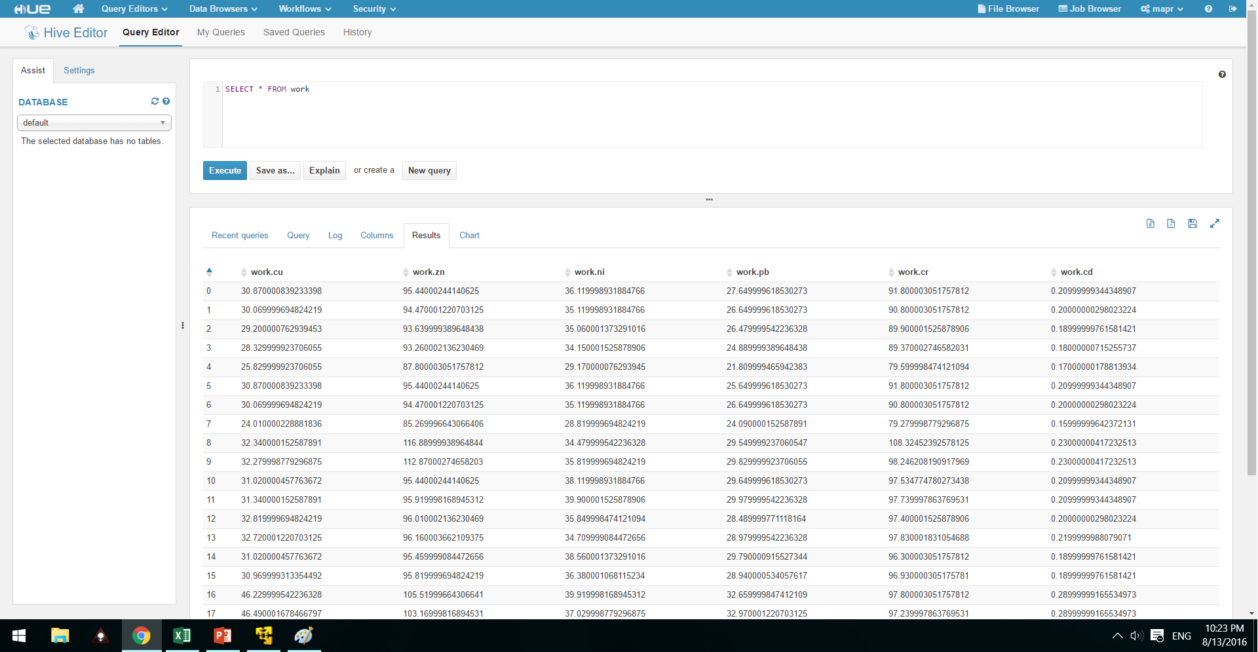
Implementation – Data Warehouse
Hive query results from HUE – heavy metals
Notes:
Second, run Hive query commands to trim, filter and sort the data by selected columns.

Slide 15
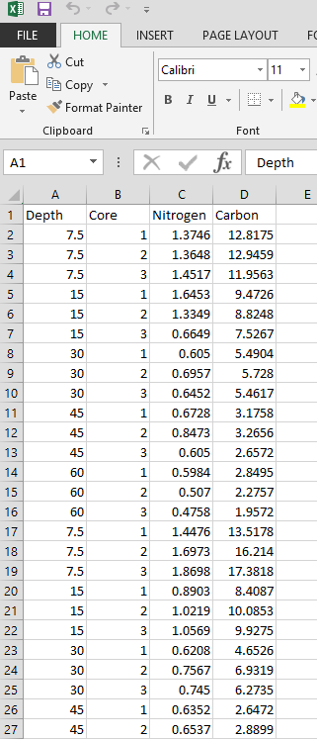
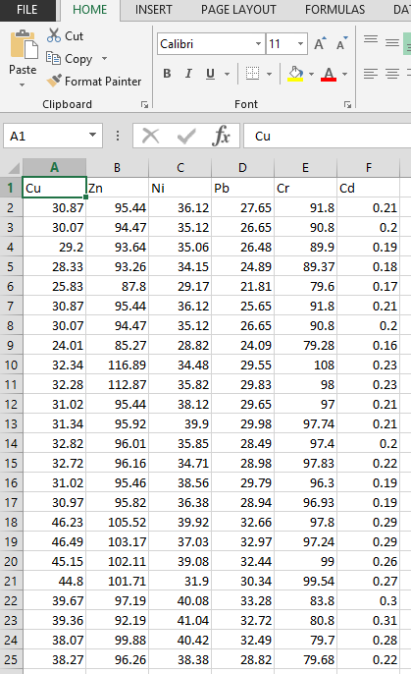
Implementation – Statistical Analysis
Selected columns from Hive queries are exported as .csv files. After treatment from data warehouse, data sets are trimmed, filtered and sorted. It is ready for further analysis.
Notes:
Third, export selected columns in .csv files. After query analysis from Hive, selected relevant columns are exported in .csv files. Users can either download .csv files from Hive, or connect Hive with R, and access data from R terminal.

Slide 16
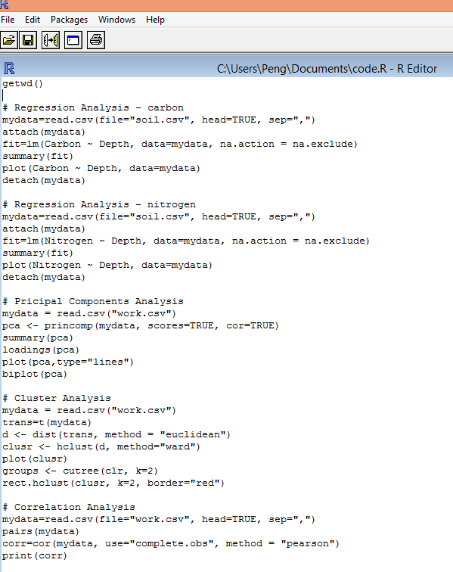
Implementation – Statistical Analysis
Regression analysis
Principal component analysis
Cluster analysis
Correlation analysis
Commands in R to access Hive database:
library(RHive)
rhive.connect(host, port, hiveServer2)
Notes:
In this project, the data obtained from HUE were treated statistically using R and Excel software. However, users can also access Hive Server data from R directly, by using Rhive package.

Slide 17
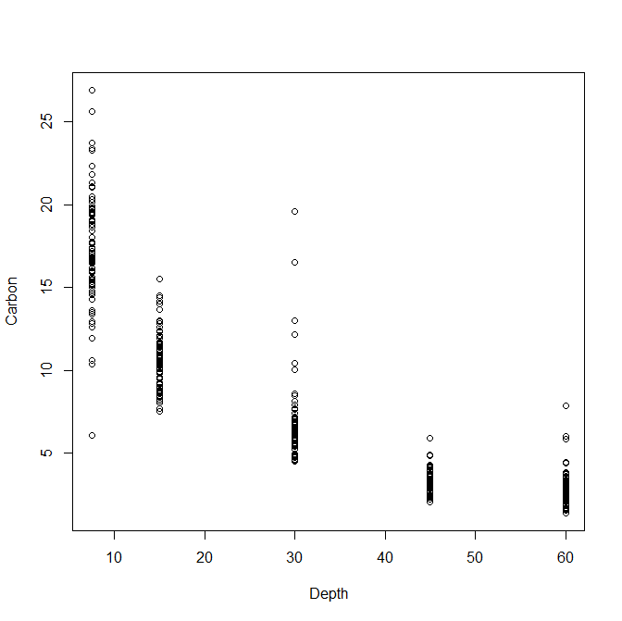
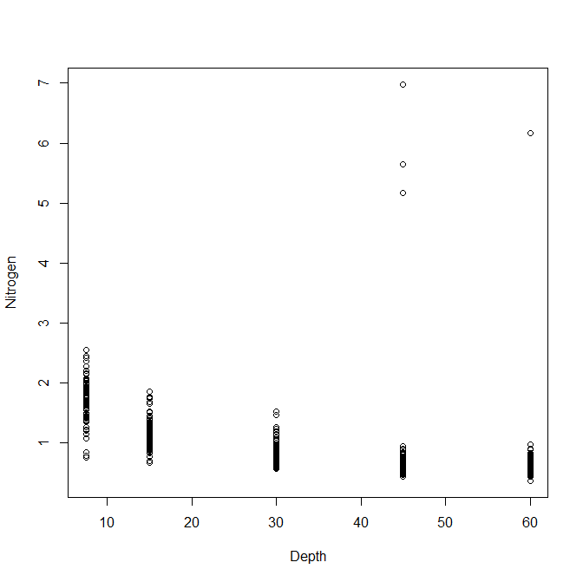
Regression Analysis – Carbon and Nitrogen
Implementation – Statistical Analysis
Results showed that a negative relationship between soil carbon, nitrogen and depth.
Notes:
We can see a negative relationship between soil carbon, nitrogen and depth, indicating soil carbon and nitrogen contents decrease with increasing depth. These results are meaningful and useful for farmers to determine what crop to grow in different location.

Slide 18
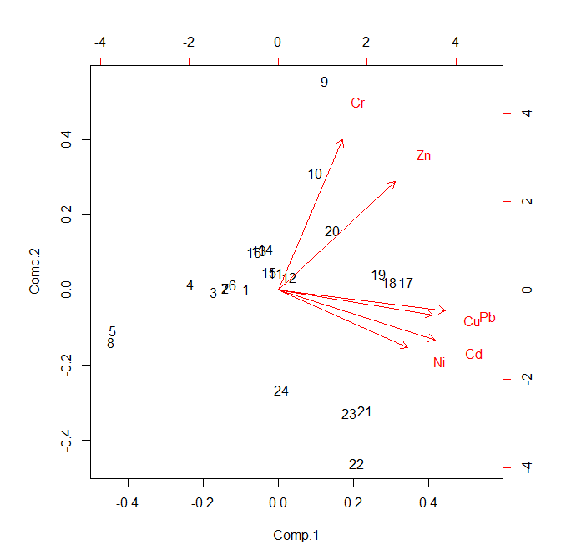
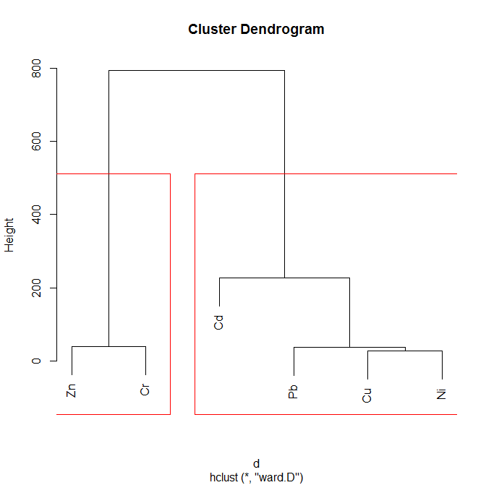
Principal Component Analysis and Cluster Analysis
Implementation – Statistical Analysis
Two principle components are found. PC1 includes Cu, Ni, Pb and Cd, and PC2 includes Zn and Cr.
Notes:
For heavy metals, we can see two groups as shown above. There two groups indicates that they both have various sources. One group might come from natural source (Cr and Zn), and the other might caused by human activity (Ni, Cd, Cu, and Pb). Farmers can determine what crop to grow with heavy metal contents. Those heavy metals with natural source is ignorable, while those with human activity source should be paid attention to, as usually, the heavy metals caused by human are harmful to plants.

Slide 19
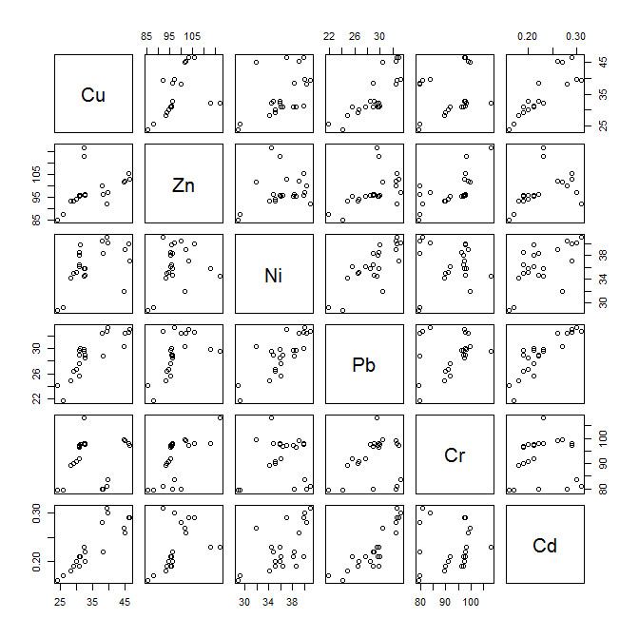
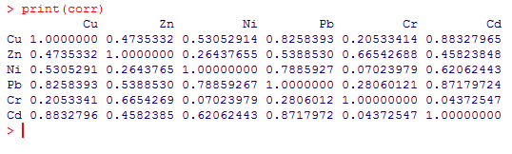
Correlation Analysis
Implementation – Statistical Analysis
Correlation reconfirmed the two groups.
Notes:
Same two groups.

Slide 20
Conclusion
Big data analytics are useful and necessary for soil property investigation.
The tools in this project trimmed, filtered, and sorted raw data in soil investigation and simplified the further data analysis processes.
These applications help researcher explore further soil investigation, and provide opportunities to implement machine learning techniques in traditional experimental research.

